Slide 1
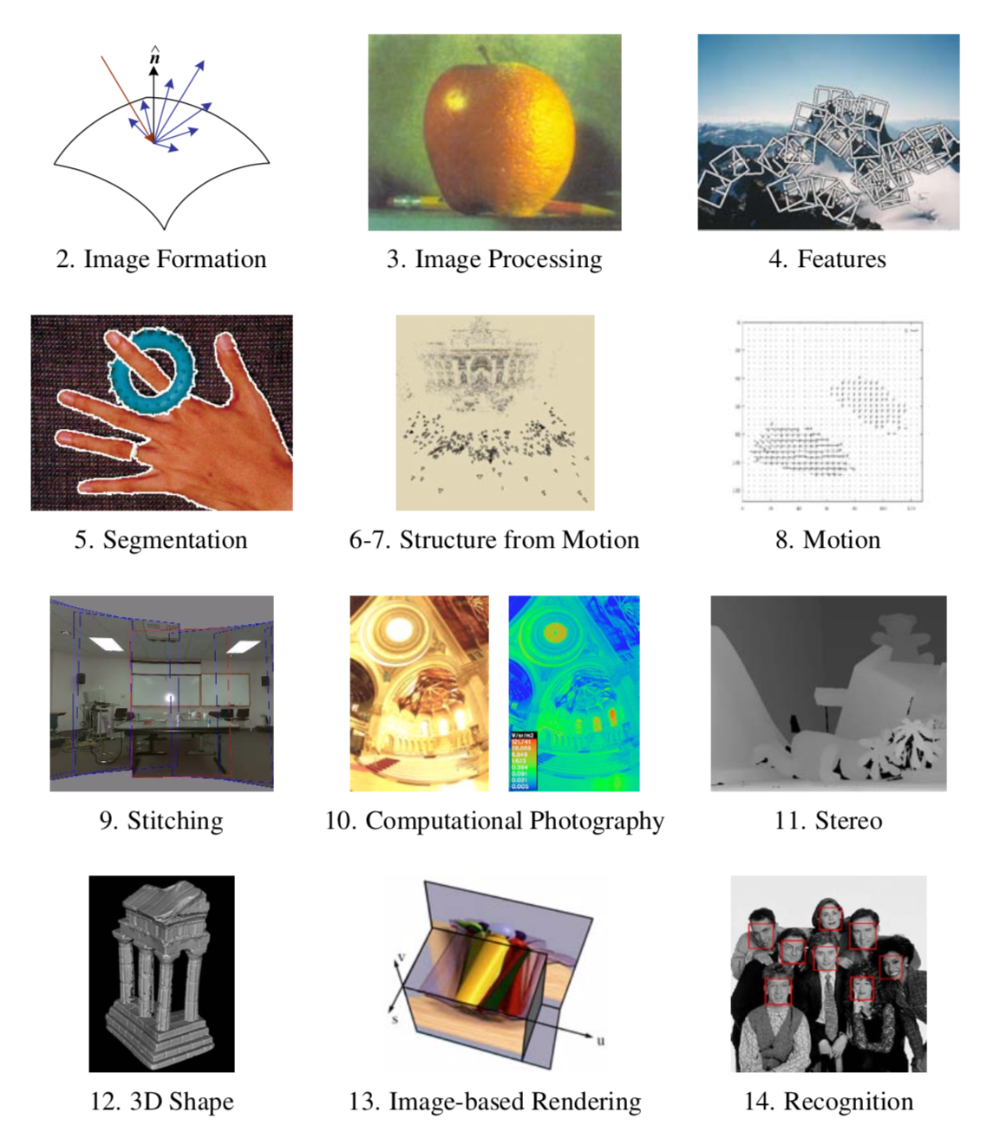

Slide 2
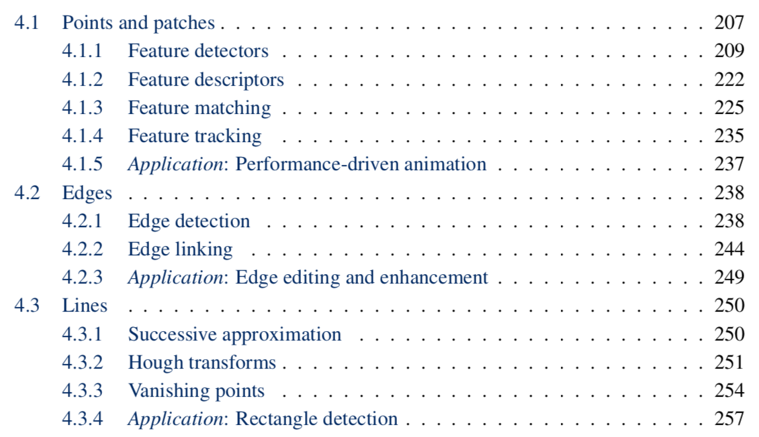

Slide 4
Detectors

Slide 5

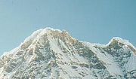
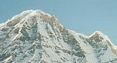
Local features: main components
Detection: Identify the interest points
Description: Extract vector feature descriptor surrounding each interest point.
Matching: Determine correspondence between descriptors in two views
Kristen Grauman

Slide 6
History
Moravec 1980
Harris Corners 1988
[Wolf & Platt 1993: FCN!]
SIFT (Lowe) 2004
FAST 2006 (learning!)
SURF 2006
ORB 2011

Slide 7
Harris corner detector
Compute M matrix for each image window to get their cornerness scores.
Find points whose surrounding window gave large corner response (f> threshold)
Take the points of local maxima, i.e., perform non-maximum suppression
C.Harris and M.Stephens. “A Combined Corner and Edge Detector.” Proceedings of the 4th Alvey Vision Conference: pages 147—151, 1988.
Notes:
7

Slide 8
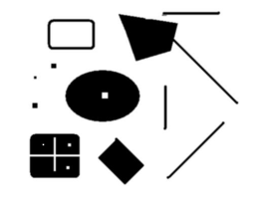
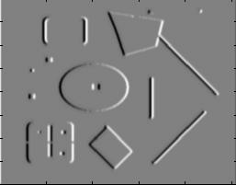
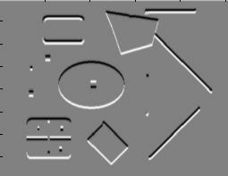
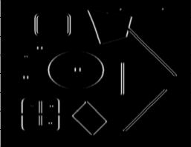
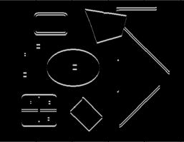
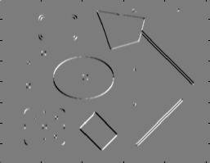
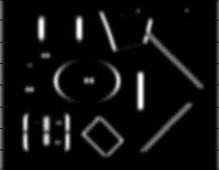
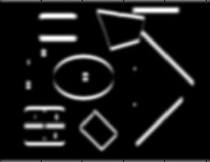
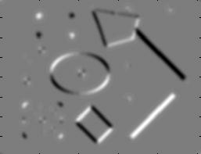
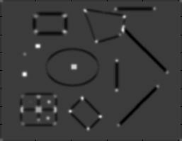
Harris Detector [Harris88]
Second moment matrix
1. Image derivatives
I_{x}
I_{y}
(optionally, blur first)
I_{x}²
I_{y}²
I_{x}I_{y}
2. Square of derivatives
3. Gaussian filter g(σ_{I})
g(I_{x}²)
g(I_{y}²)
g(I_{x}I_{y})
4. Cornerness function – both eigenvalues are strong
5. Non-maxima suppression
har

Slide 9
Deep Detectors

Slide 10
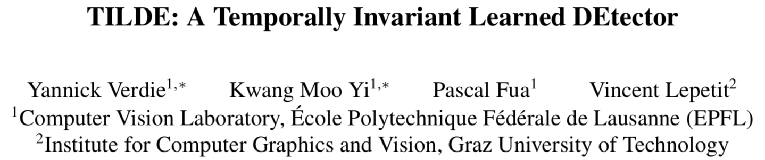
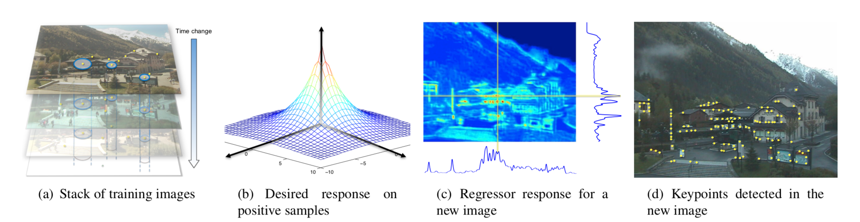
CVPR 2015
Train on images from webcams: fixed view, different times
Learn CNN-like regressor
Loss = repeatability

Slide 11
Descriptors

Slide 12
Local features: main components
Detection: Identify the interest points
Description: Extract vector feature descriptor surrounding each interest point.
Matching: Determine correspondence between descriptors in two views
Kristen Grauman

Slide 13
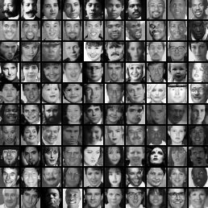
Image representations
Templates
Intensity, gradients, etc.
Histograms
Color, texture, SIFT descriptors, etc.

Slide 14
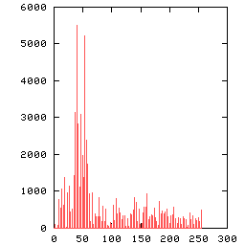
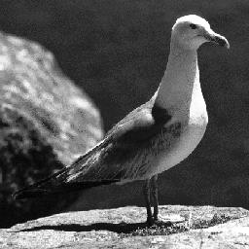
Image Representations: Histograms
Global histogram
Represent distribution of features
Color, texture, depth, …
Space Shuttle Cargo Bay
Images from Dave Kauchak

Slide 15
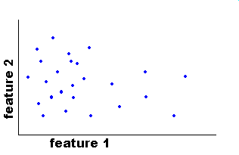
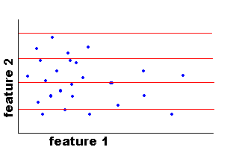
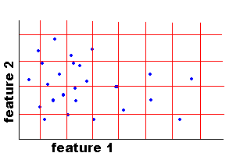
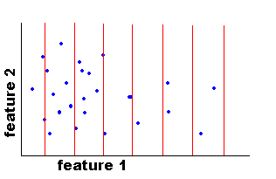
Image Representations: Histograms
Histogram: Probability or count of data in each bin
Joint histogram
Requires lots of data
Loss of resolution to avoid empty bins
Marginal histogram
Requires independent features
More data/bin than joint histogram
Images from Dave Kauchak

Slide 16
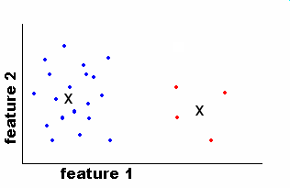
Image Representations: Histograms
Clustering
EASE Truss Assembly
Use the same cluster centers for all images
Space Shuttle Cargo Bay
Images from Dave Kauchak

Slide 17
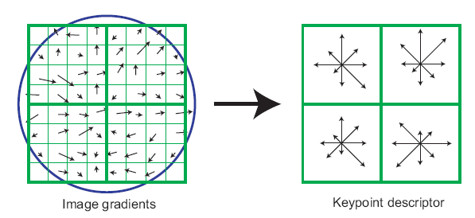
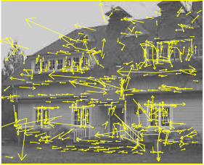
What kind of things do we compute histograms of?
Histograms of oriented gradients
SIFT – Lowe IJCV 2004

Slide 18

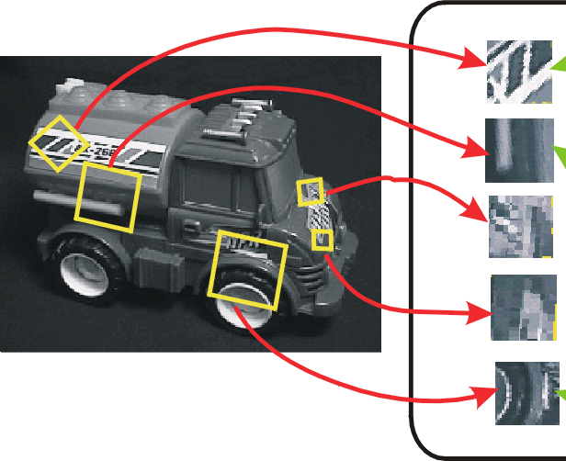
SIFT vector formation
Computed on rotated and scaled version of window according to computed orientation & scale
resample the window
Based on gradients weighted by a Gaussian of variance half the window (for smooth falloff)

Slide 19
SIFT vector formation
4x4 array of gradient orientation histogram weighted by magnitude
8 orientations x 4x4 array = 128 dimensions
Motivation: some sensitivity to spatial layout, but not too much.
showing only 2x2 here but is 4x4

Slide 20
Ensure smoothness
Gaussian weight
Interpolation
a given gradient contributes to 8 bins: 4 in space times 2 in orientation

Slide 21
Reduce effect of illumination
128-dim vector normalized to 1
Threshold gradient magnitudes to avoid excessive influence of high gradients
after normalization, clamp gradients >0.2
renormalize

Slide 22
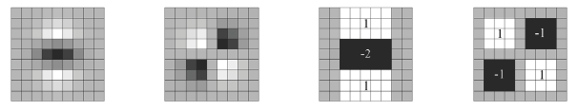
Local Descriptors: SURF
Fast approximation of SIFT idea
Efficient computation by 2D box filters & integral images ⇒ 6 times faster than SIFT
Equivalent quality for object identification
GPU implementation available
Feature extraction @ 200Hz (detector + descriptor, 640×480 img)
http://www.vision.ee.ethz.ch/~surf
[Bay, ECCV’06], [Cornelis, CVGPU’08]

Slide 23
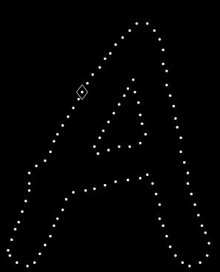
Local Descriptors: Shape Context
Count the number of points inside each bin, e.g.:
Count = 4
...
Count = 10
Log-polar binning: more precision for nearby points, more flexibility for farther points.
Belongie & Malik, ICCV 2001
K. Grauman, B. Leibe

Slide 24
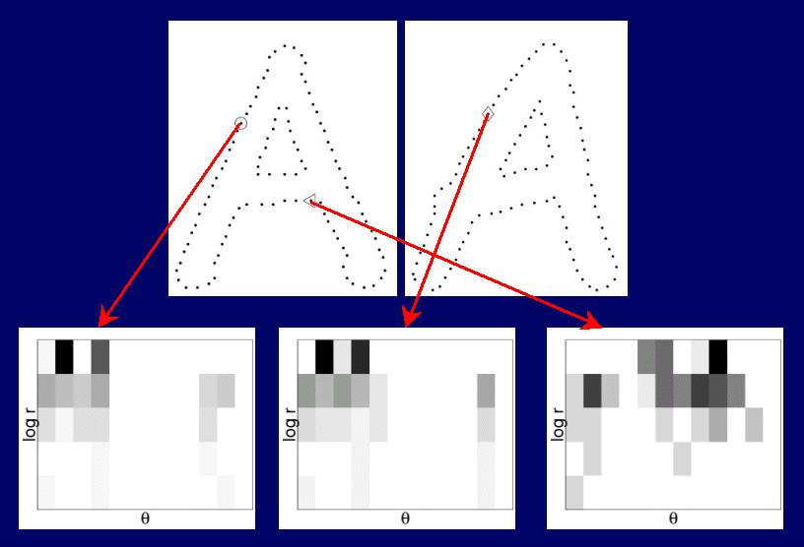
Shape Context Descriptor

Slide 25
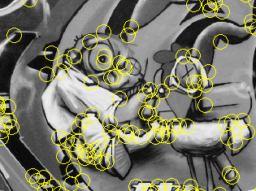
Things to remember
Keypoint detection: repeatable and distinctive
Corners, blobs, stable regions
Harris, DoG
Descriptors: robust and selective
spatial histograms of orientation
SIFT

Slide 26
Deep Descriptors

Slide 27
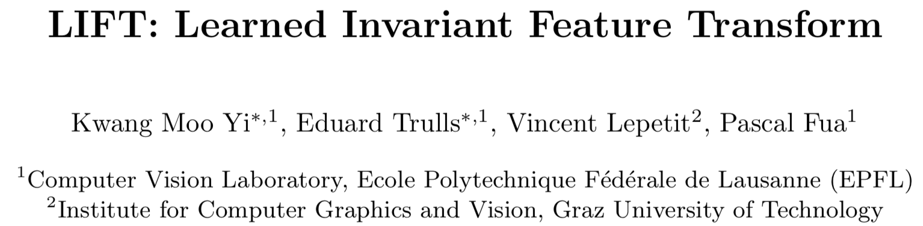
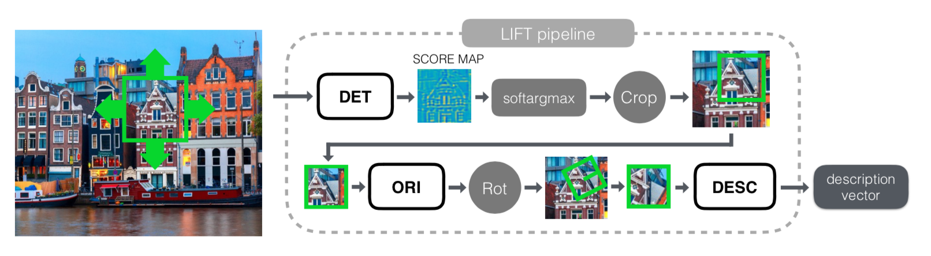
ECCV 2016
Three networks: detection, orientation, description
detection+orientation -> STN -> descriptor
Trained separately :-(

Slide 28
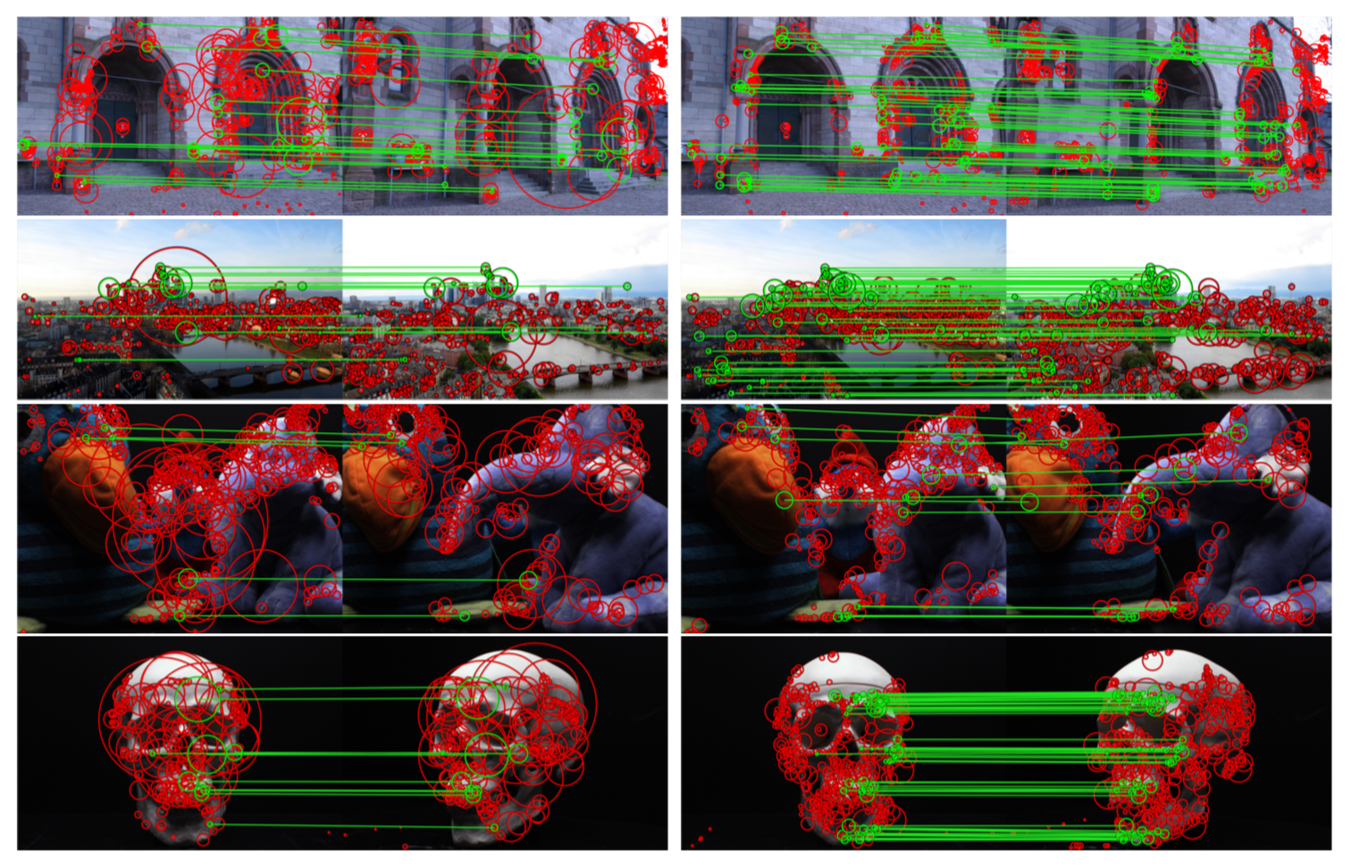
SIFT vs. LIFT

Slide 29
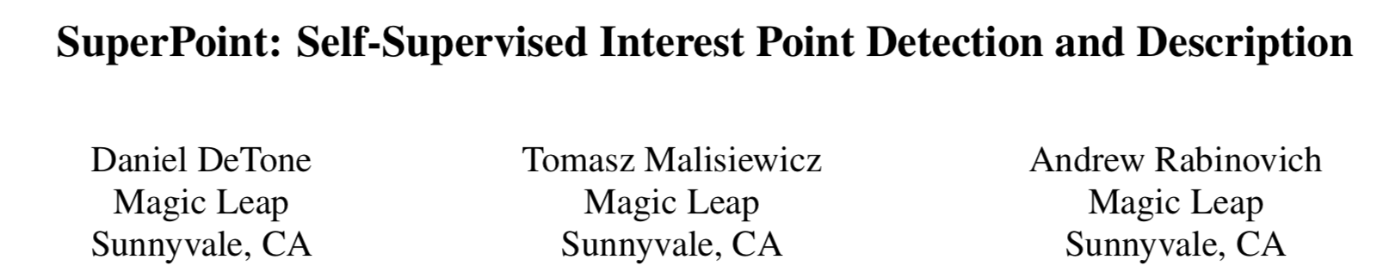
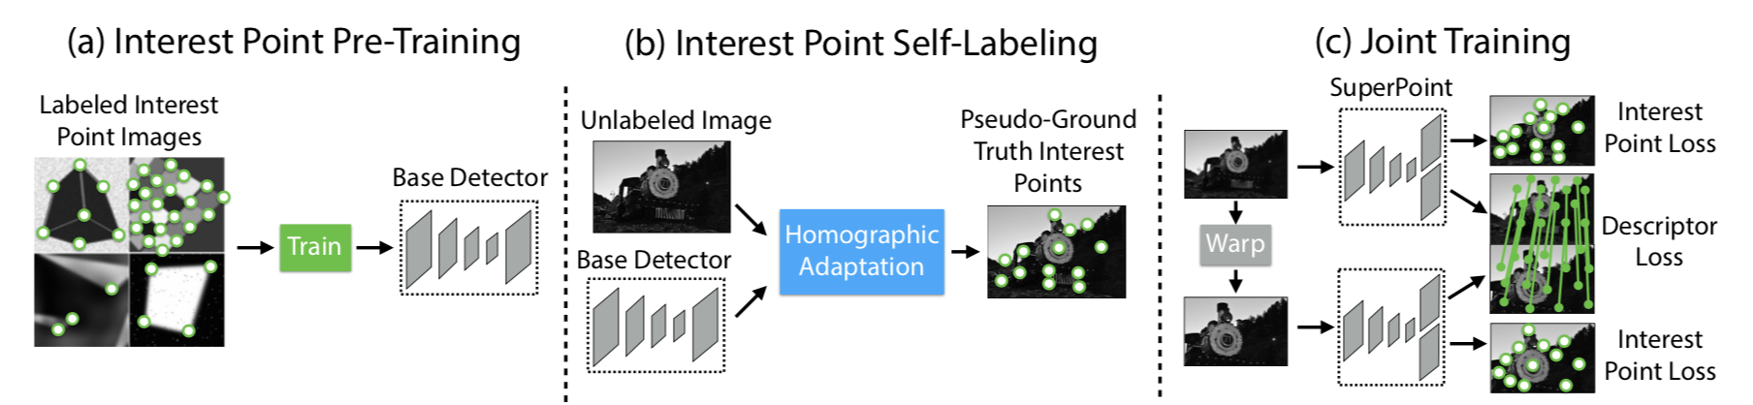
2018 CVPR Workshop
Interest point = ill-defined -> self-supervised
MagicPoint -> SuperPoint

Slide 30
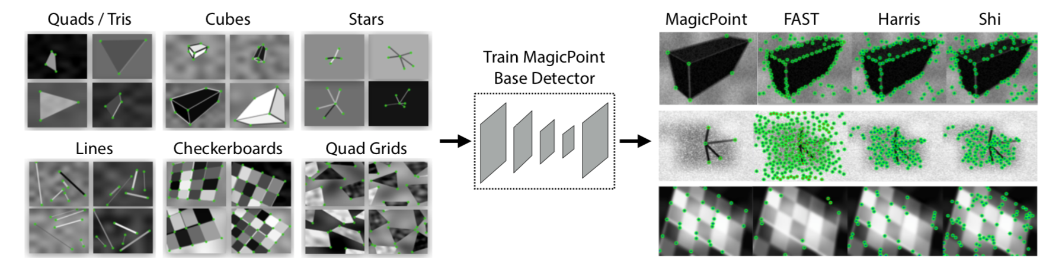
MagicPoint

Slide 31
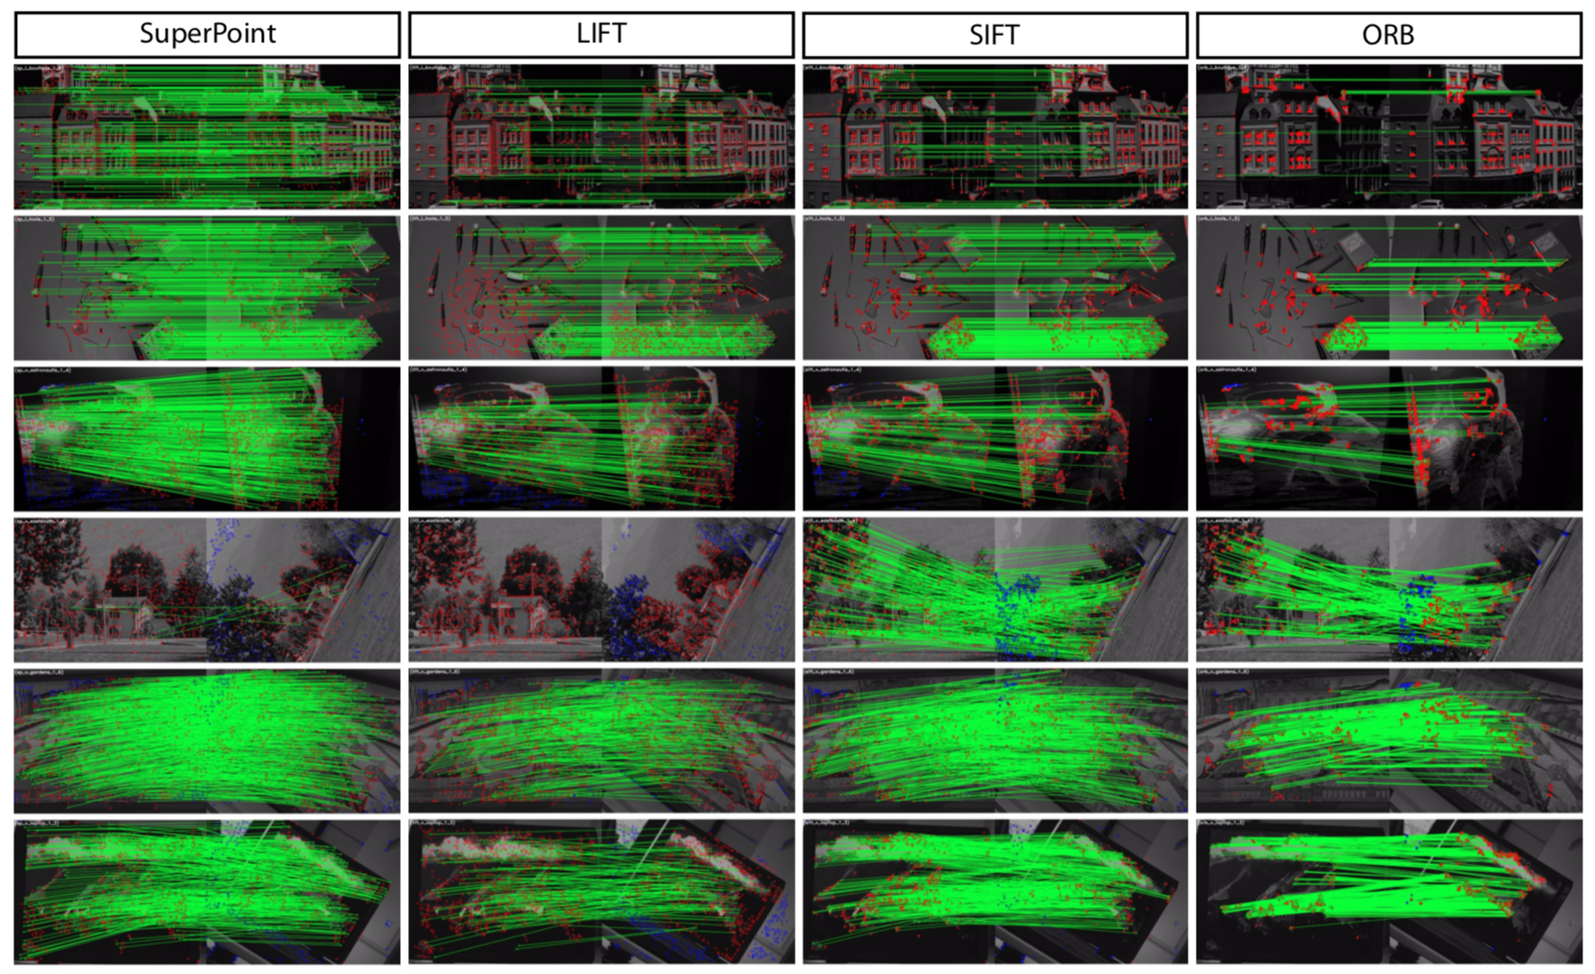
SuperPoint Results

Slide 32
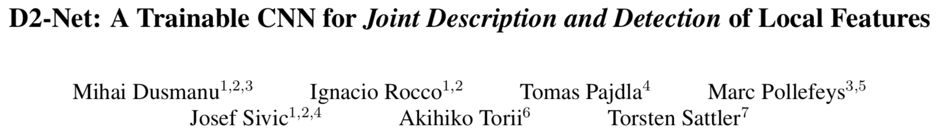
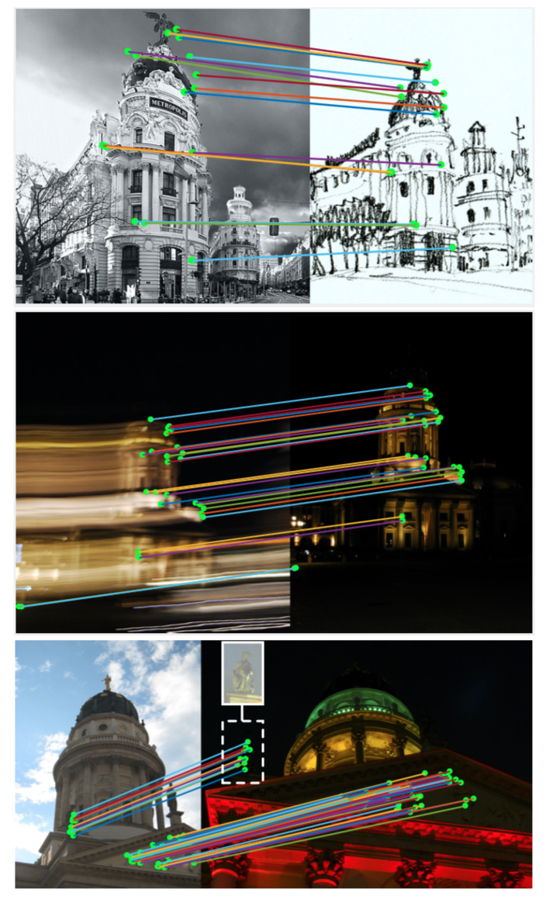
CVPR 2019
Tensor viewed as descriptors and detector maps
VGG16-based, loss encourages distinctiveness and repeatability
Results beat the star of the art in day-night and indoor localization, but not in more traditional settings (Superpoint shines for HPatches, GeoDesc for SFM)

Slide 33
Matching

Slide 34
Local features: main components
Detection: Identify the interest points
Description: Extract vector feature descriptor surrounding each interest point.
Matching: Determine correspondence between descriptors in two views
Kristen Grauman

Slide 35
Matching
Simplest approach: Pick the nearest neighbor. Threshold on absolute distance
Problem: Lots of self similarity in many photos

Slide 36
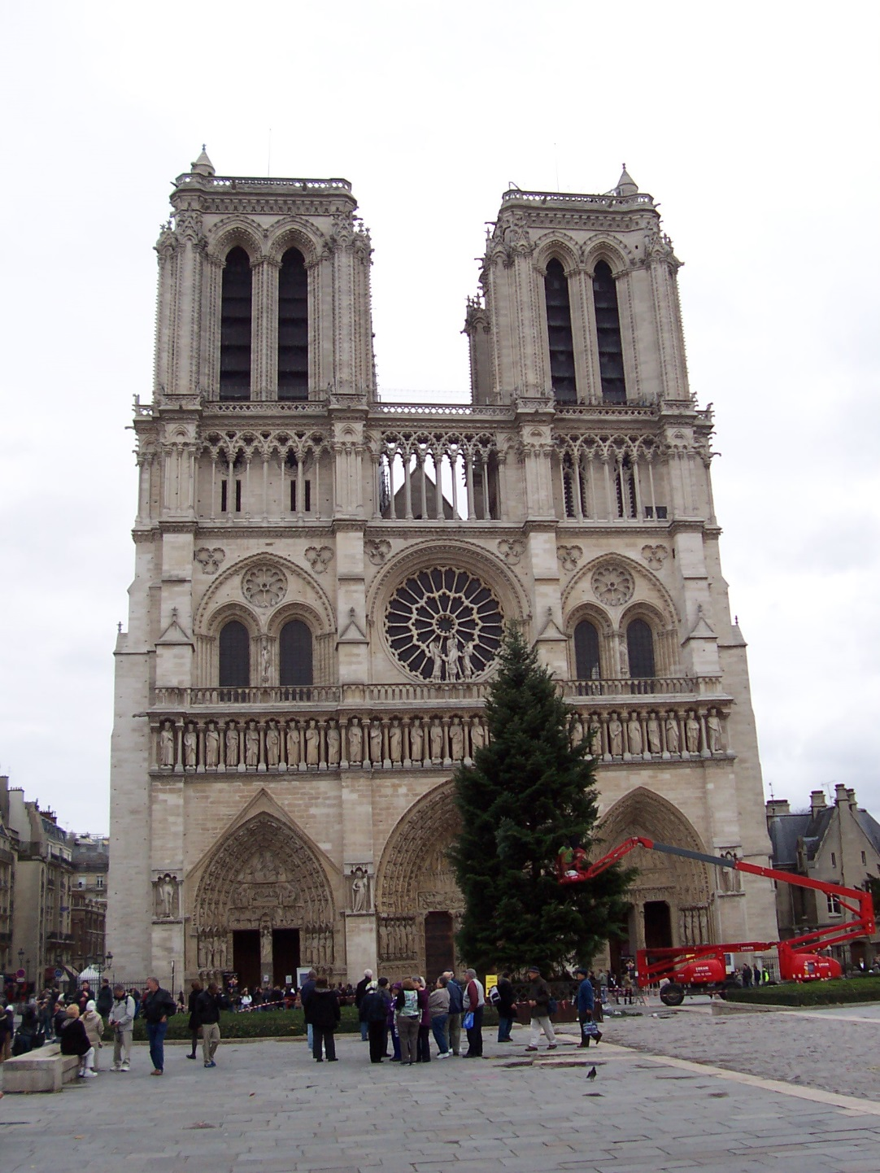
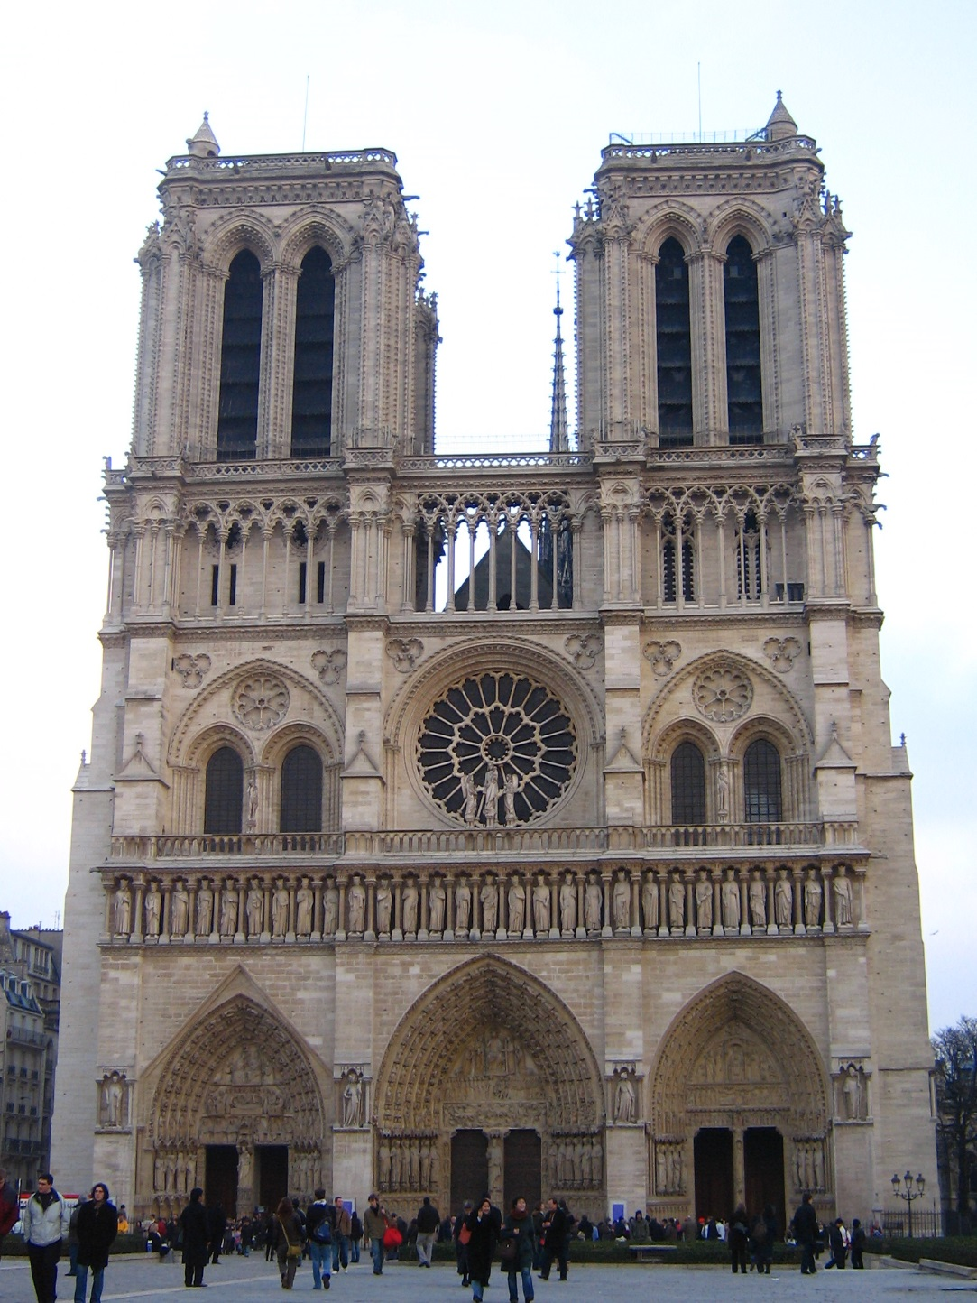
Distance: 0.34, 0.30, 0.40 Distance: 0.61
Distance: 1.22

Slide 37
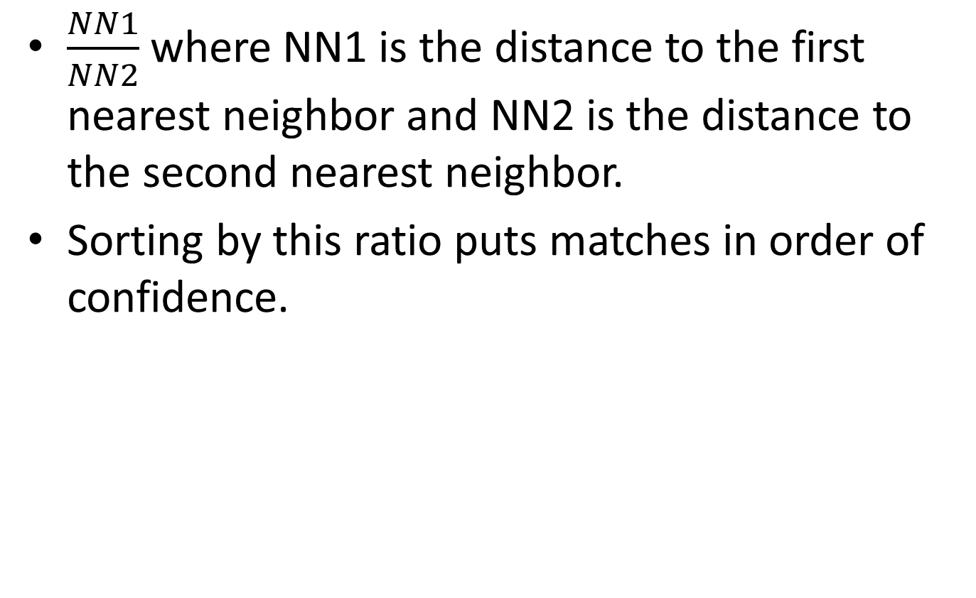
Nearest Neighbor Distance Ratio
$\frac{NN1}{NN2}$ where NN1 is the distance to the first nearest neighbor and NN2 is the distance to the second nearest neighbor.
Sorting by this ratio puts matches in order of confidence.

Slide 38
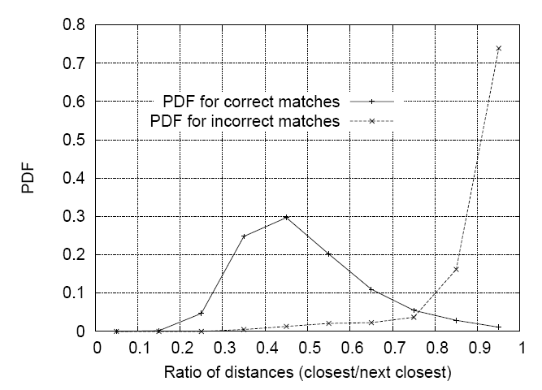
Matching Local Features
Nearest neighbor (Euclidean distance)
Threshold ratio of nearest to 2nd nearest descriptor
Lowe IJCV 2004

Slide 39
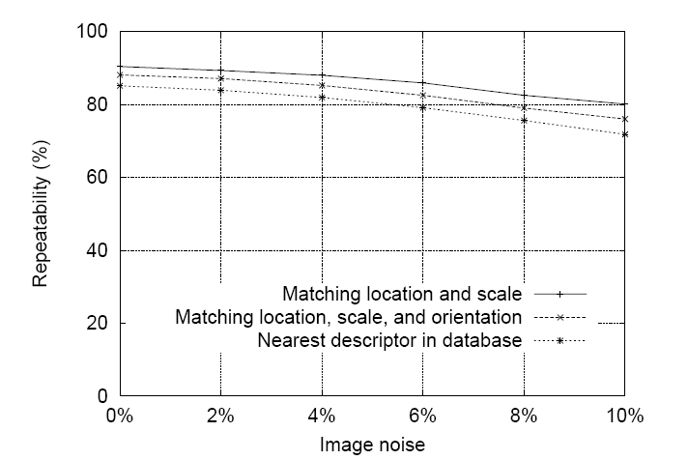
SIFT Repeatability
Lowe IJCV 2004

Slide 40
SIFT Repeatability

